Slide 1
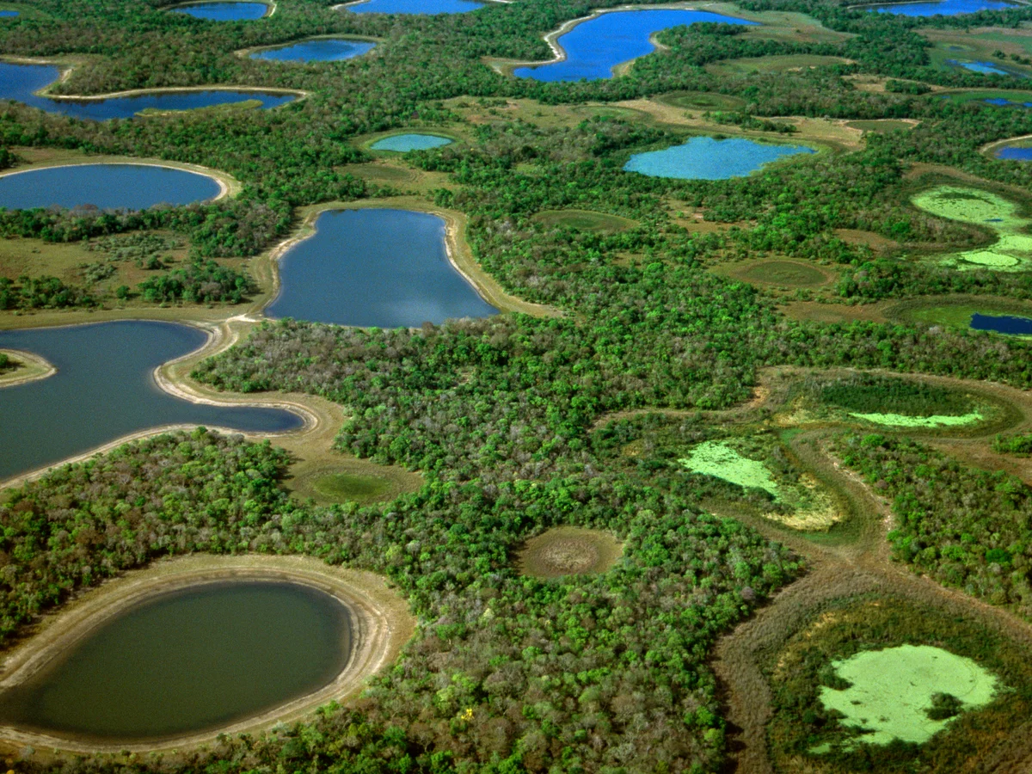
THE PANTANAL WETLAND
The Pantanal is the world's largest tropical wetland area, spanning mostly through Brazil, with parts extending into Bolivia and Paraguay. Covering an estimated 140,000 to 180,000 square kilometers, this immense ecosystem functions like a giant reservoir that floods during the rainy season and dries out in the winter. It is renowned for its extraordinary biodiversity, hosting thousands of plant and animal species, including the world's highest concentration of jaguars and caimans. Due to its global environmental importance in climate regulation and water purification, parts of the Pantanal are designated as a UNESCO World Heritage Site.
Would you like to narrow down this information? I can provide specific details on:
The best time to visit for tourism
The unique wildlife found there
Current environmental threats like wildfires

Slide 2
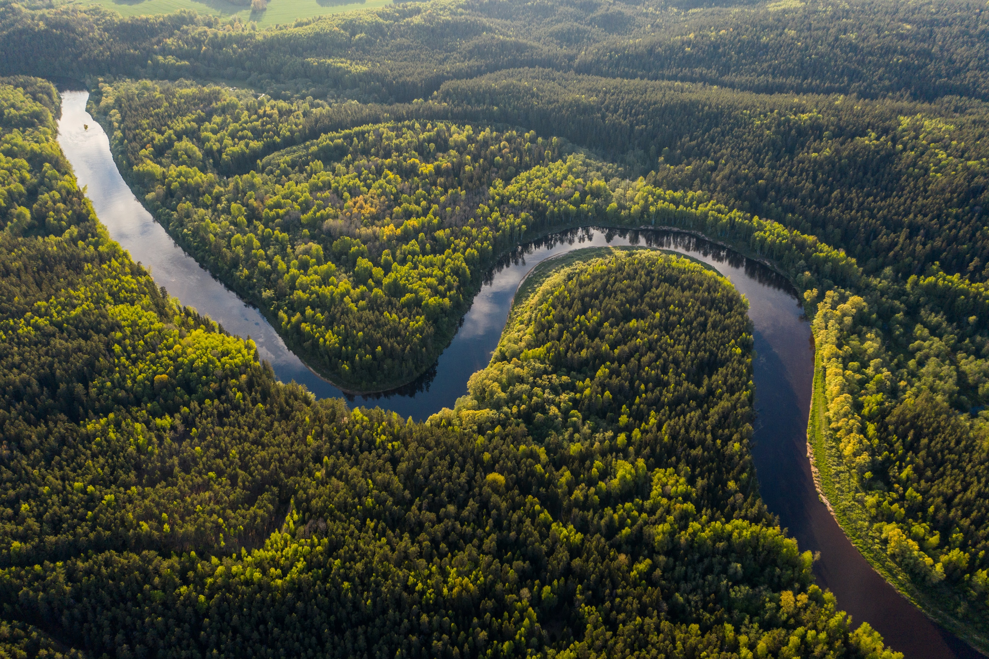
THE AMAZON RIVER BASIN WETLAND
The Amazon River Basin is the largest drainage system in the world, covering nearly 40% of South America across nine countries. It contains the planet's largest tropical rainforest, which acts as a vital global climate regulator and supports unparalleled biodiversity. Fed by over a thousand tributaries, the massive Amazon River itself accounts for roughly 20% of the world's total river flow into the oceans.
If you want to focus on a specific aspect of the basin, please tell me if you prefer to learn about its unique wildlife, indigenous communities, or environmental threats.

Slide 3
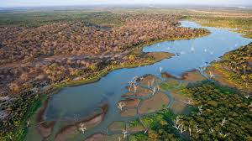
OKAVANGO DELTA WETLAND
The Okavango Delta in Botswana is a stunning inland river oasis where the Okavango River empties into the Kalahari Desert. This unique ecosystem floods during the dry winter months, attracting thousands of animals and creating one of Africa’s premier wildlife sanctuaries. Known for its rich biodiversity, visitors can spot elephants, lions, and rare birds while exploring the tranquil water channels in traditional dugout canoes called mokoros.
If you want to tailor this, please let me know:
* Is this paragraph for a school project, a travel brochure, or a social media post?
* What is the word count you need?
* Should it focus more on the animals, the geography, or safari travel?

Slide 4
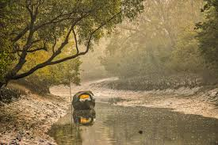
THE SUNDERBANS WETLAND
The Sundarbans is the world's largest mangrove forest, spanning across India and Bangladesh along the Bay of Bengal. This UNESCO World Heritage Site is formed by the confluence of the Ganges, Brahmaputra, and Meghna rivers. It is globally famous for its rich biodiversity, serving as the unique, water-locked home of the endangered Royal Bengal tiger. Beyond its wildlife, this vast network of tidal waterways and islands acts as a crucial natural barrier against powerful tropical storms.
To help me tailor more information for you, please let me know:
Is this paragraph for a school project, travel planning, or general interest?
Do you want to focus more on the wildlife or the environmental threats?
What is the ideal word count you need?

Slide 5
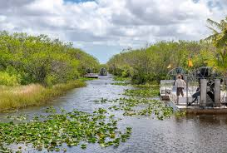
THE EVERGLADES WETLAND
The Everglades is a massive, 1.5-million-acre subtropical wetland located in southern Florida. Often called the "River of Grass," this unique ecosystem consists of a shallow, slow-moving river that flows through diverse habitats like pinelands, mangrove forests, and freshwater marshes. It is a famous UNESCO World Heritage site celebrated for its incredible biodiversity. Visitors flock here to see iconic wildlife, including alligators, manatees, and rare wading birds. It is also the only place on Earth where alligators and crocodiles coexist in the wild.
To help me tailor this description, could you share:
* Your target audience (e.g., kids, tourists, students)?
* The main focus you want (e.g., wildlife, travel tips, environmental issues)?
* The exact word count you need?

